Slide 1
205 Oct 11, Class 8
Chapter 8, Research Ethics
  Fair and equitable treatment of human research participants
Time permitting: Writing/Exam review

Slide 2
In an effort to determine the effects of the drug chlorpromazine on the cognitive performance of schizophrenics, two clinical investigators randomly selected 20 acute schizophrenics from a mental hospital population.
The patients were asked to order several stimuli along some dimension, such as ordering eight stimuli by weight.
There were several tasks of this sort.
The investigators used a within-participant design in which all participants first performed the tasks after being injected with a saline solution (placebo) and then performed the tasks again several hours later after being injected with chlorpromazine.
The results indicated that fewer errors were made in the chlorpromazine treatment, which suggested to the investigators that the drug facilitates more adequate cognitive functioning in this type of patient.

Slide 3
Chapter 8
Research Ethics
  Fair and respectful treatment of participants in research
Basic Ethical Principles (Belmont Report)
  Respect for Persons
    Consent is voluntary
    Vulnerable populations are protected
  Beneficence
    Good outweighs the risk
  Justice
    Fairness in distribution

Slide 4
Famous ethical transgressions
Tuskegee Syphilis Study
Guatemala Syphilis
Willowbrook State School Hepatitis studies
Milgram studies
Zimbardo prison studies

Slide 5
Historical Events in Research Ethics
Nuremberg Code, 1947
  Response to Nazi researchers
Declaration of Helsinki, 1964
  Broader statement of principles
Belmont Report, 1979
  Respect for persons
  Beneficence
  Justice
APA Code of Ethics
  Includes integrity

Slide 6
IRB
What is the main goal and purpose of the Institutional Review Board?

Slide 7
Informed Consent
Before participating in a research experiment, all participants should generally read and sign an informed consent form. What are 3 main goals of this process intended to maintain ethical standards for the scientific work?

Slide 8
Ethical scientific practice
Assure fair treatment of participants
Institutional Review Board (IRB)
  Reviews all formal research
  Risk/benefit analysis
Informed Consent
  Right to withdraw
  Full disclosure: risks, benefits, procedure
  Privacy

Slide 9
Why is deception considered an ethically challenging practice in experimental design?
  What do experimenters need to include in the research process if deception is used?
Give an example of a group considered a “vulnerable population” and explain how this affects the process of doing ethical research.

Slide 10
Common risks in psychological science
Deception
  Lying to participants about the experiment
    Sneaky dependent variables
  Sometimes necessary for good design
Privacy
  Protecting identification of participants
  Which condition, whether you were in the study
Frustration/fatigue
Emotional manipulation

Slide 11
In a study of attitudes about extramarital affairs, a researcher finds that an acquaintance has participated in the study and reports having cheated on their spouse. They then find themselves torn about whether to report this information to the spouse. What kind of research ethics problem has occurred here? What research procedures should be used to keep this from occurring?

Slide 12
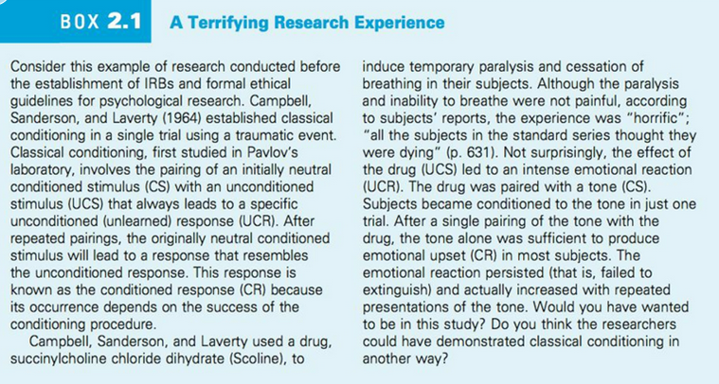

Slide 13
First Exam Content
Chapter 2: Measurement
  Turning constructs into experiment variables
Chapter 3 & 4: Experimental control
  Identifying, eliminating or managing extraneous variables
Chapter 5: Statistics
  Descriptive statistics and t-test
Chapter 7: Within-participants design
Chapter 8: Ethics

Slide 14
For Mon Oct 14
Exam 1
  Covers Chapters 1-8
  Prior exams posted to see format
    Note that specific topics covered were different in prior quarters
    Different tools/programs used for statistics
    You should be familiar with the output from R

Slide 15
APA Report Sections
Abstract
  Very concise summary, ~200 words
Introduction
  Construct, background, hypothesis
Methods
  Participants, materials, procedure
Results
  Figure
Discussion
  Conclusion, interpretation, limitations
References

Slide 16
APA Format: Methods
Which of the following is the main goal of the methods section of a research report?
  a. Meticulously articulate how you analyzed the data.
  b. Provide enough detail to allow an independent researcher to replicate your study.
  c. Outline the demographic information of your participants so that reviewers can access the generalizability of your research.
  d. Discuss the procedure you used so that readers can decide for themselves if your protocol is biased.

Slide 17
APA Format: Results
Which of the following is usually beyond the scope of the results section of a quantitative research report?
  a. Discussing what statistical techniques were used
  b. Presenting figures and/or tables to portray the data
  c. Providing detailed interpretation of the implications based on the data
  d. Presenting specific statistics that were generated from the data

Slide 18
APA Format: Discussion
If you state alternative explanations in your discussion, which of the following should you also consider doing?
  a. Tell readers why the alternative explanation falls short of the primary explanation
  b. Conduct statistics tests to test them specifically
  c. Include reviewer opinions of whether they think the alternative explanation is better or worse than the primary explanation
  d. Present a literature review that would allow readers to conduct a follow-up study based on the alternative explanation

Slide 19
APA Writing with Style
What is the role played by answering the question “who will you write for” in writing a research report? How should the answer influence the writing process?
Citing previous research
  Craik & Tulving (1972) proposed that better memory would research from more semantic engagement with the material being studied and termed this “deeper” processing.

Slide 20
Background literature
APA format for the References section
  Craik, F. I. M., & Lockhart, R. S. (1972). Levels of processing: A framework for memory research. Journal of verbal learning and verbal behavior, 11(6), 671-684.
  Craik, F. I. M., & Tulving, E. (1975). Depth of processing and the retention of words in episodic memory. Journal of experimental Psychology: general, 104(3), 268.
Notes:
Demonstrate use of google scholar

Slide 21
Theory: “Deep” Encoding
Hypothesis
  What is it?
  What isn’t it?
Mechanism
  Inferred
Specific Procedures
  Used in studies to test
  Combination of testing operational definitions and underlying theory
  What if our study hadn’t worked?

Slide 22
Research Context
Building on existing work
  Strengthens confidence in conclusions
  Very briefly review theory/mechanism
Adding something new
  What is new about our study?
  Motivate the current study to add to prior work

Slide 23
Experiment 1 Methods information
Participants
  38 students from Research Methods classes
Materials
  A set of 60 words was used for the study and test stimuli. Words were selected to have a written frequency of 30-80 per million and to be 5-8 letters in length.
Procedure
  4s time per word to rate (automatic advance)
    “For each word, rate how much you like the word on a 1 to 5 scale. 5 means you like the word very much and 1 means you dislike the word very much. Indicate your rating with keyboard or mouse.”
    “For each word, count the number of vowels in each word. Enter the number with keyboard or mouse"
  3m delay period completing trivia questions
  60 item post-test, 30 old, 30 new

Slide 24
Results
Include all of:
  Descriptive statistics: mean, SD, SE
  Inferential statistics: t-test in APA format
  Figure & caption
As discussed in class, will be very compact

Slide 25
First writeup
Include title page, abstract
Introduction: 1-2 paragraphs citing prior work, noting what is new about this study
Methods: full detail
Results: full detail including Figure and caption
Discussion: 1-2 paragraphs summarizing conclusion, note limitations
  Finish on strong positive statement!
References:

Slide 26
Research definition
  “A systematic investigation, including development, testing, and evaluation, designed to develop or contribute to generalizable knowledge”
    Not including: case studies, biography or oral history research, classroom activities, publicly available data

